Slide 1
OENG1118 Sustainable engineering practice and design
Weeks 3 & 4: Engineering design for sustainability
Phase 2: Conceptual design
Notes:
We’ll start our processes for the Conceptual Design phase. We’ll generate a set of plausible concepts to solve our problem, and then we’ll select for further development the concept with the highest potential to satisfy our design requirements.

Slide 2
Course convener
Peter Stasinopoulos
peter.stasinopoulos@rmit.edu.au
57.03.36, City Campus

Slide 3
Engineering design for sustainability: skills
Define sustainable development or regenerative development in the context of your product’s life cycle
Compile non-overlapping sets of design requirements and performance indicators
Develop theoretical targets for the design requirements
Project
Demonstrate each of the 3 skills

Slide 4
Engineering design for sustainability: skills
Incorporate frugal subsystems and processes
Incorporate biomimetic subsystems and processes
Increase eco-efficiency
Increase eco-effectiveness
Identify leverage points using whole system thinking
Follow the optimal design sequence
Optimise the useful lifetime
Project
Demonstrate at least 5 of the skills

Slide 5
Frugal innovation
Notes:
We’ll use a strategy called frugal innovation to introduce design options that decrease economic costs to sustainable levels while maintaining the primary functions.

Slide 6
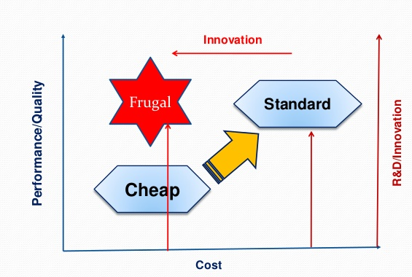
Frugal innovation
Originated in emerging markets; now also in developed markets
Frugal: husband our resources carefully by thoughtfully making the most of everything we have and wasting as little as possible.
Good because it is enough
Ample because it is sufficient
(Leadbeater 2014)
Notes:
“New products or services which focus on fundamental needs, spare use of resources, or eliminate non-essential functions to simplify the design” (Kuo 2017).
Leadbeater, C., 2014, The Frugal Innovator - Creating Change on a Shoestring Budget, Palgrave Macmillan, p. 49.
Kuo, A., 2017, ‘Harnessing frugal innovation to foster clean technologies’, Clean Technologies and Environmental Policy, vol. 19, no. 4, pp. 1109-1120.
Husband: to use economically.

Slide 7
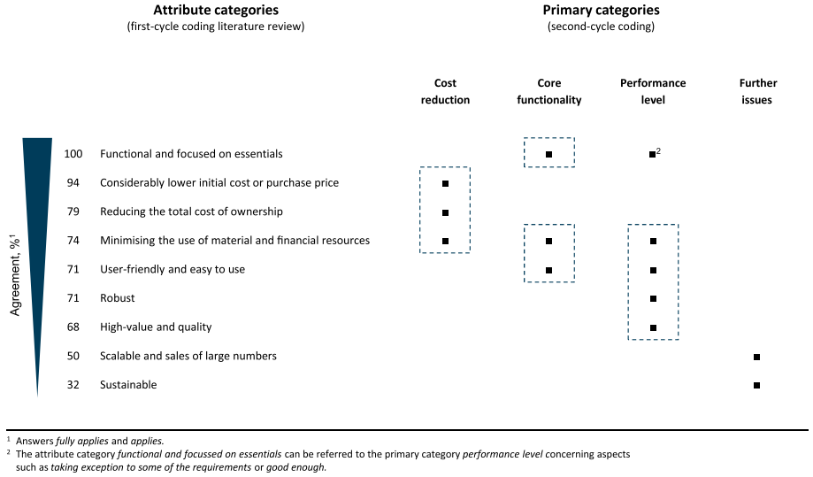
Frugal innovation
(Weyrauch & Herstatt 2016)
Notes:
Weyrauch, T. and Herstatt, C., 2016, ‘What is frugal innovation? Three defining criteria’, Journal of Frugal Innovation, vol. 2, no. 1.

Slide 8
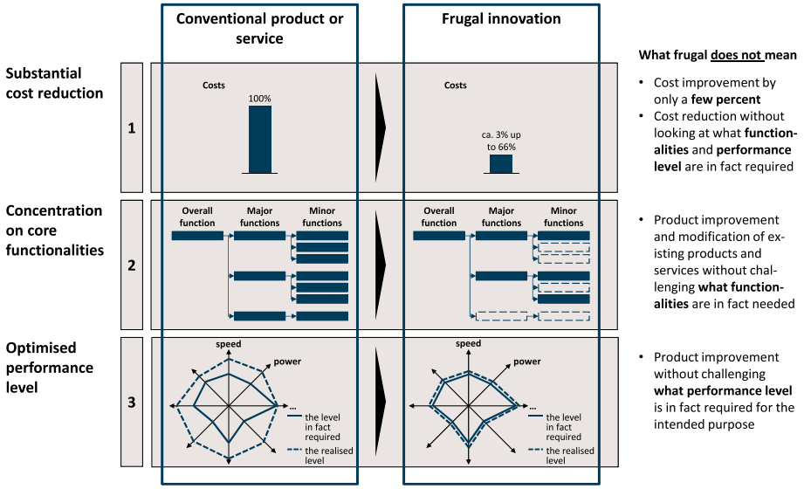
Frugal innovation
(Weyrauch & Herstatt 2016)
Notes:
Weyrauch, T. and Herstatt, C., 2016, ‘What is frugal innovation? Three defining criteria’, Journal of Frugal Innovation, vol. 2, no. 1.

Slide 9
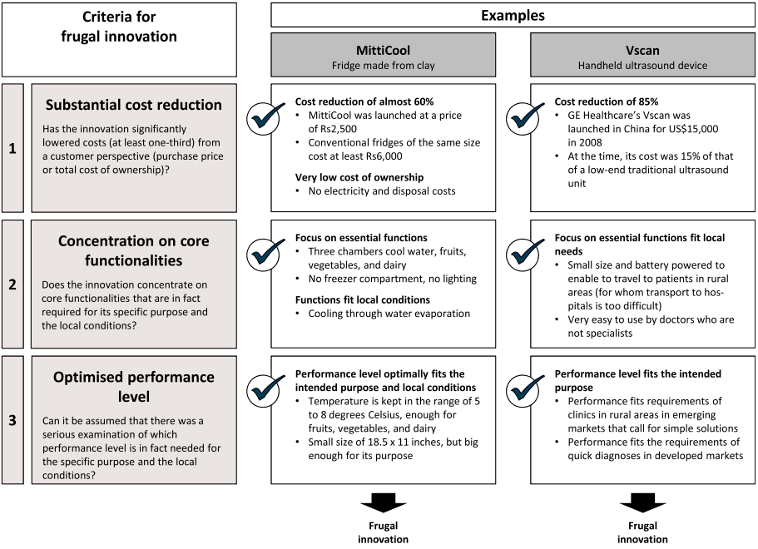
Frugal innovation
(Weyrauch & Herstatt 2016)
Notes:
Weyrauch, T. and Herstatt, C., 2016, ‘What is frugal innovation? Three defining criteria’, Journal of Frugal Innovation, vol. 2, no. 1.

Slide 10
Frugal innovation
Characteristics (Kuo 2014):
Focusing on the fundamental needs or the essence of needs
Eliminating non-essential functions of products
Trimming down the processes (e.g., service processes or manufacturing processes)
No-frill
Cost-cutting
Tough (frugal products need to adapt to harsh environments in the emerging or developing world)
Ease of use
Sparing use of resources
Notes:
Kuo, A., 2017, ‘Harnessing frugal innovation to foster clean technologies’, Clean Technologies and Environmental Policy, vol. 19, no. 4, pp. 1109-1120.

Slide 11
Frugal innovation
Rules of thumb (Leadbeater 2014):
Ask for what is impossible
Thrive on Crisis, Work in Margins
Welcome constraints
Learn to be Lean
Simplify
To Create Value, Share it
Waste is Fuel
Blend, Do Not Invent
Think Like a Movement
Innovate New Business Models
Notes:
Bold rules are design principles
Leadbeater, C., 2014, The Frugal Innovator - Creating Change on a Shoestring Budget, Palgrave Macmillan, pp. 138-139, 181-188.
The Frugal Recipe
Frugal innovation creates better outcomes for more people, while using fewer resources, by developing completely different solutions.
At the core of frugal innovations are the four linked design principles: lean and simple, clean and social.
They are lean to eliminate waste in all forms. Lean thinking finds the most direct, efficient and elegant way to create what customers most value. It eliminates waste tied up in time-consuming bureaucracy, inflexible equipment and rigid systems. To be lean, frugal solutions also have to be simple.
Simple solutions can be used by more people, more easily. Complex products and technologies are more costly to develop, use and maintain. Simple solutions tend to be easier to use, more robust and easier to maintain. Simple solutions focus on the features that make most difference to consumers; look familiar, so they are easy to learn; and provide consumers with a complete solution, not just a fragment of one.
Innovations that are lean and simple can be low-cost without being frugal. To be fully frugal they also need to be clean: to minimise their environmental impact. Clean solutions rely on ‘re’-thinking: reuse, recycle, repurpose, remediate. They treat waste as fuel, use local renewable resources and are designed to work within natural systems.
Finally, frugal solutions make the most of being social to: engage consumers in adapting and innovating solutions; spread virally through word of mouth emulation and imitation; and share the costs among many people. Social, shared solutions will often be more economic than individualised, tailored ones. Frugal innovators work with the grain of cooperation to devise solutions with people.
These four design principles – lean and simple, clean and social – are central to how and where frugal innovation happens and who does it.

Slide 12
Frugal innovation
56 solution patterns deduced from 29 frugal innovations
Most popular solution patterns:
Training of local talents (21%)
Use of natural resources (21%)
Cooperation with the government (17%)
(Lehner & Gausemeier 2016)
Notes:
Lehner, A. and Gausemeier, J., 2016, ‘A pattern-based approach to the development of frugal innovations’, Technology Innovation Management Review, vol. 6, no. 3, pp. 13-21.

Slide 13
Frugal innovation
Skill: Incorporate frugal subsystems and processes
Activity
Distinguish between the essential requirements and the non-essential requirements of your system
Example – passenger vehicle:
Essential: protect passengers from wind
Non-essential: protect passengers from noise
Identify frugal options that are relevant to your system

Slide 14
Biomimicry
Notes:
We’ll use a strategy called biomimicry to introduce design options that are well adapted to a sustainable or regenerative biosphere.

Slide 15
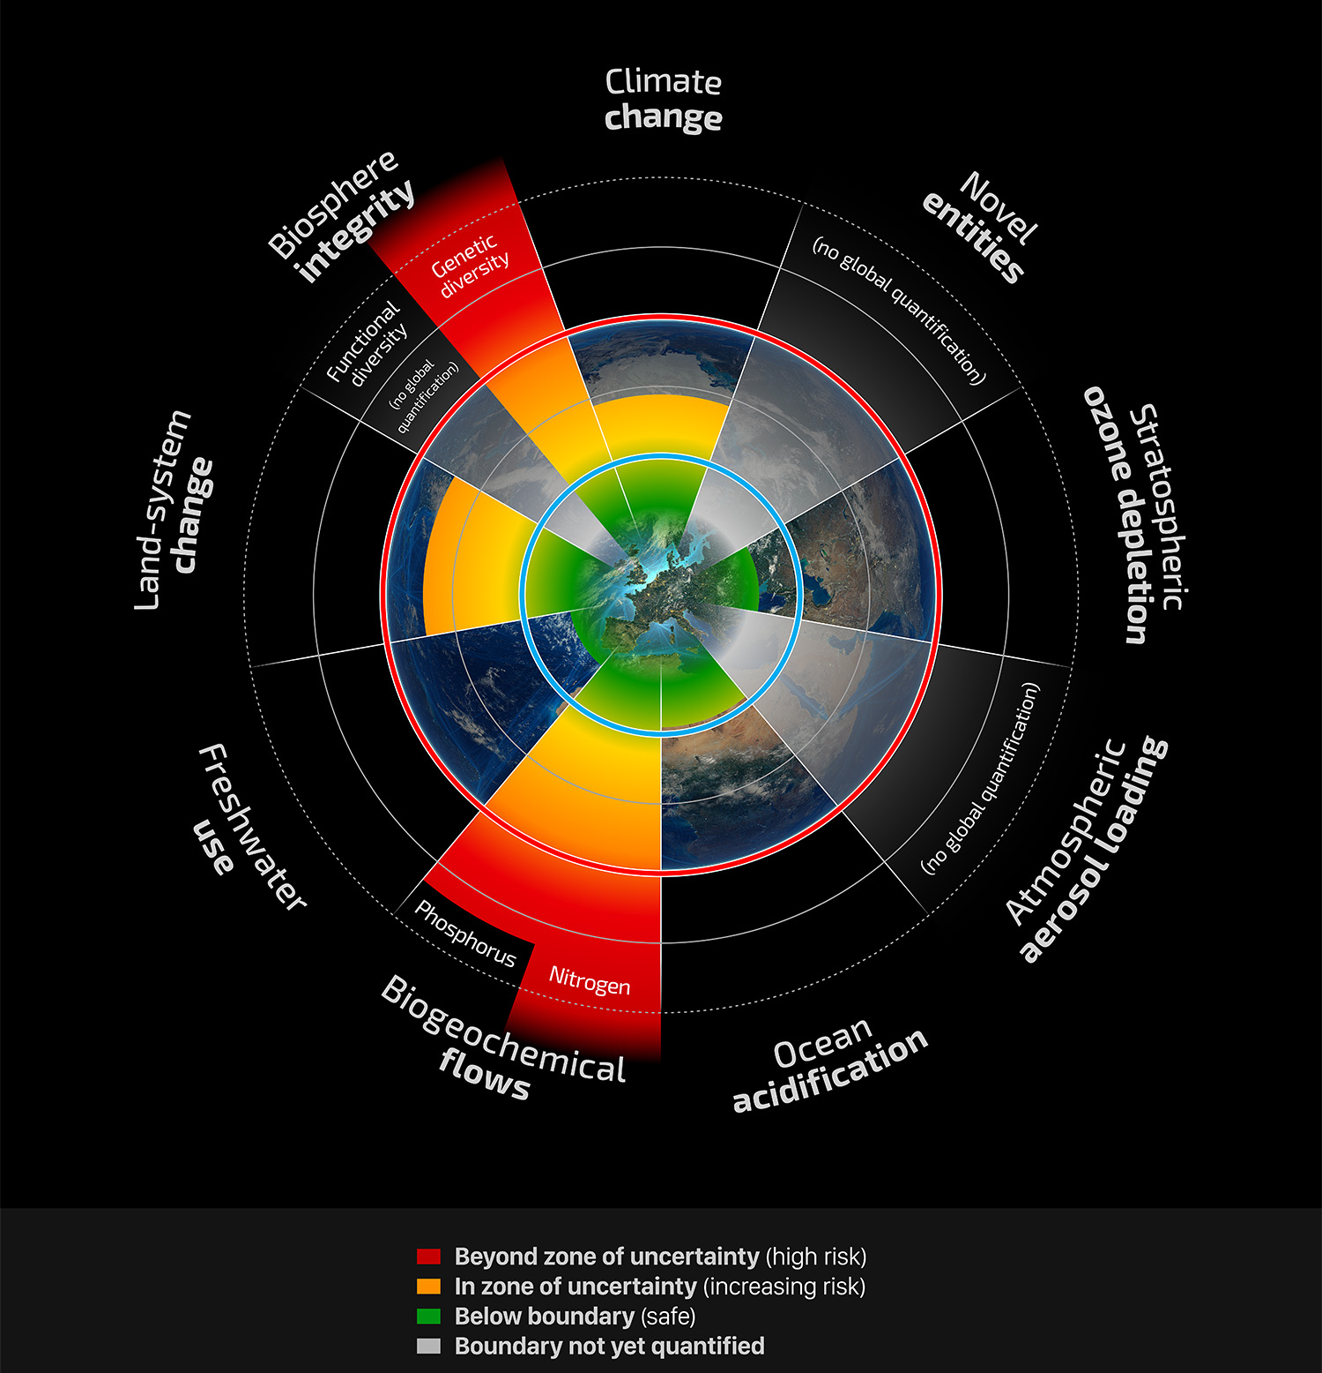
Biomimicry
Planetary boundaries
(Stockholm Resilience Centre, based on Steffen et al. 2015)

Slide 16
Biomimicry
Nature as mentor
Innovation inspired by nature
Art of asking nature for advice
Learning
Helps us to develop systems that meet the customer requirements while being in harmony with the planet’s natural systems

Slide 17
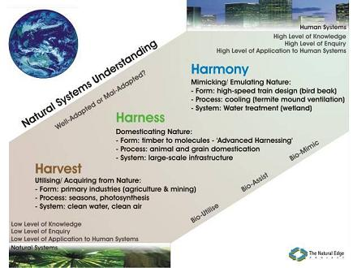
Biomimicry
Nature as model
(The Natural Edge Project, Biomimicry Guild 2006)
Notes:
Smith, M., Hargroves, K., Paten, C., and Palousis, N. (2007) Engineering Sustainable Solutions Program: Critical Literacies Portfolio - Principles and Practices in Sustainable Development for the Engineering and Built Environment Professions, The Natural Edge Project (TNEP), Australia.

Slide 18
Biomimicry
Nature as measure
Standard or benchmark against which to compare the performance of our systems
In nature, most products and services are biotic
Living as part of a system
Fit in the system
Survive only as long as needed
In nature, most processes occur in life-friendly conditions
Ambient temperature
Low pressure
Low toxicity

Slide 19
Biomimicry
Principles (Benyus 2002):
Nature runs on sunlight
Nature uses only the energy it needs
Nature fits form to function
Nature recycles everything
Nature rewards cooperation
Nature banks on diversity
Nature demands local expertise
Nature curbs excesses from within
Nature taps the power of limits
Notes:
Benyus, J. (2002) Biomimicry: Innovation inspired by nature, HarperCollins, New York.

Slide 20
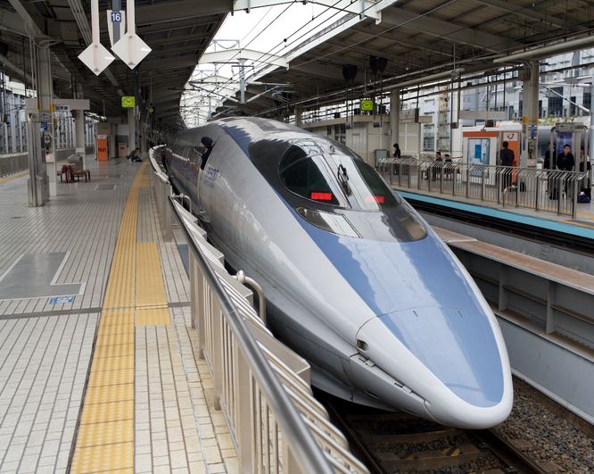
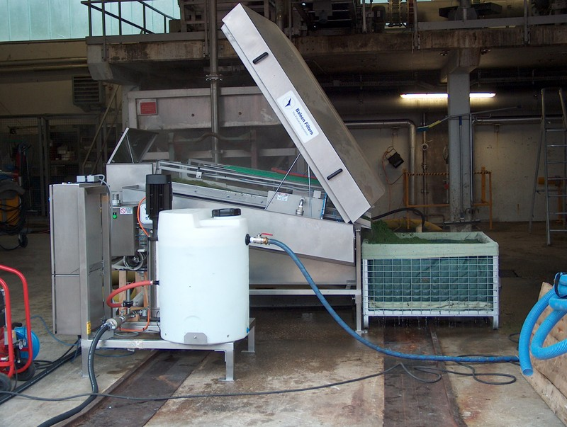
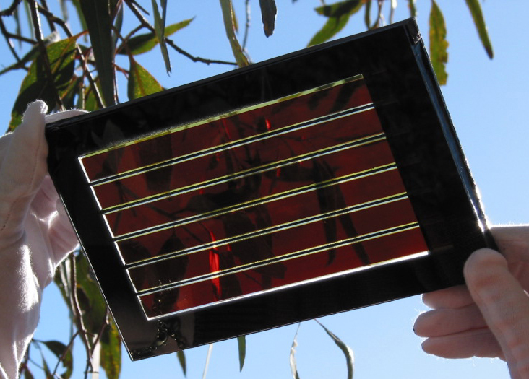
Biomimicry
Examples:
Shinkansen Bullet Train inspired by splashless water entry of kingfishers, silent flight of owls
10% faster, 15% less electricity, quieter
Self-cleaning water filtering system inspired by filter-feeding whales
Highly efficient, non-pressurised, self-cleaning, no chemicals
Dye Solar Cell technology inspired by the photosynthesis process in plants
Lower cost, lower embodied energy, more efficient, can be incorporated into glass panels
(AskNature)
Notes:
AskNature, Shinkansen Train, https://asknature.org/idea/shinkansen-train/#.XI3ritozZYF
AskNature, Baleen Filters water filters, https://asknature.org/idea/baleen-filters-water-filters/#.XI3qRNozZYE
AskNature, Dye Solar Cell Technology, https://asknature.org/idea/dye-solar-cell-technology/#.XI3qm9ozZYE

Slide 21
Biomimicry
Skill: Incorporate biomimetic subsystems and processes
Activity
Identify, on the AskNature database, 1-3 strategies or ideas that are relevant to your system

Slide 22
Eco-efficiency
Notes:
We’ll use a strategy called eco-efficiency to introduce design options that decrease the resource requirements to sustainable levels.

Slide 23
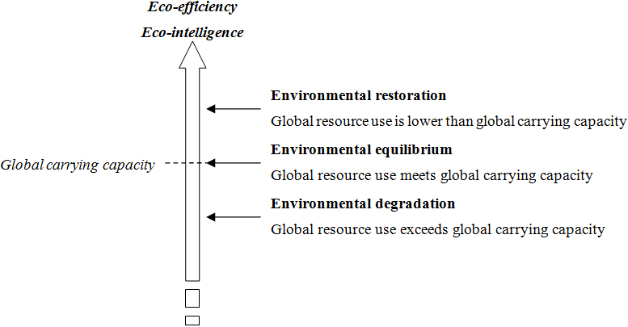
Eco-efficiency
Do more with less for longer
Minimise the resources that are discarded as waste (to within tolerable limits)

Slide 24
Eco-efficiency
Typical actions:
Decrease material, energy & land intensities
Contract the dispersion of toxic substances
Increase recyclability
Expand renewables utilisation
Extend product useful lifetime
Increase service intensity
(Lehni 2000, p. 15)
Notes:
Lehni, M. (2000) Eco-efficiency: Creating more value with less impact, World Business Council for Sustainable Development, Available at http://www.wbcsd.org/DocRoot/BugWjalu0wHL0IMoiYDr/eco_efficiency_creating_more_value.pdf. Accessed 9 November 2008.

Slide 25
Eco-efficiency
What is the optimal service?
eco-efficiency
Resource | Minimise | Maximise
Materials | Materials un-recovered Materials adversely disturbed | Materials upgraded Materials favourably dispersed
Energy | Energy un-recovered | Energy upgraded
Space | Space required
Biological impact | Toxic impact | Restorative impact

Slide 26
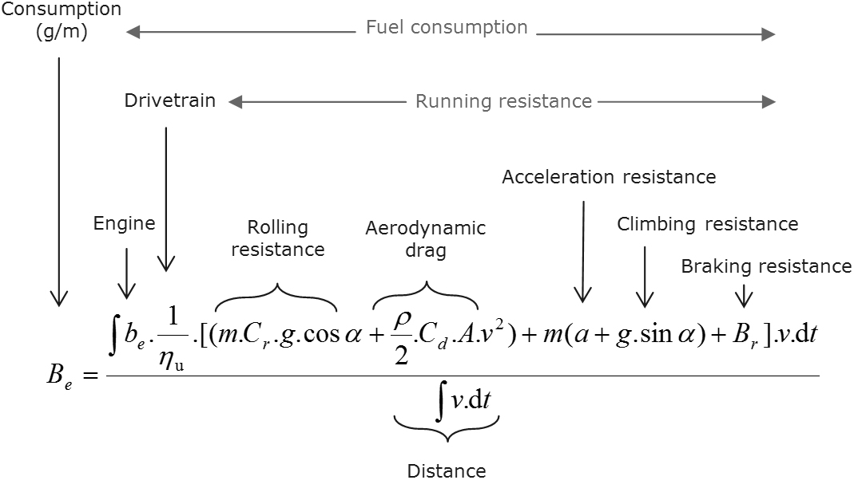
Eco-efficiency
Example: vehicle fuel consumption
(Robert Bosch GmbH 2004)
Notes:
Robert Bosch GmbH (2004) Automotive handbook, Robert Bosch GmbH, Warrendale, PA, USA, p. 417.

Slide 27
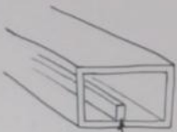
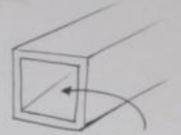
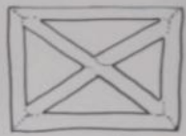
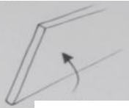
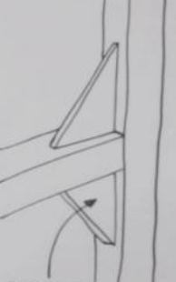
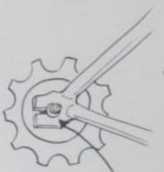
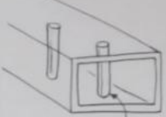
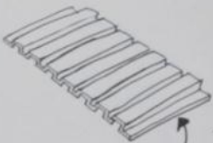
Eco-efficiency
Example: lightweighting and reinforcing strategies
(Autodesk 2018)
Hollow parts | Ribs
Thin walls | Trusses
Spot reinforcement | Gussets
Posts | Corrugation
Notes:
Autodesk 2018, Lightweighting 1: Hollow Parts, Reinforcements, and Trusses – Companion to the video: Script and Illustrations, Autodesk. Available at <https://knowledge.autodesk.com/support/inventor-products/getting-started/caas/simplecontent/content/lightweighting.html.html?st=Reinforcing%20strategies>. Accessed 16 March 2015.

Slide 28
Eco-efficiency
Examples: water productivity
Increase water productivity by:
reducing the volume of input water
directly accessing natural water sources
reusing or recycling used water
reducing the mass of water emissions
removing contaminants
replacing water with other fluids (but dry cooling and heating might increase energy consumption)

Slide 29
Eco-efficiency
Examples: water treatment
Applies to input and output water
Physical | Biological | Chemical
Membrane bioreactor | Membrane bioreactor | Disinfection
Membrane filtration | Biological treatment | Ion exchange
Basic filtration
Flotation
Notes:
We can remove contaminants by treating water
The Table shows a range of technology options under 3 categories – P B C
We can increase water productivity by treating water that is input to our system and is output from our system, thereby increasing the water quality to sustainable or regenerative levels.

Slide 30
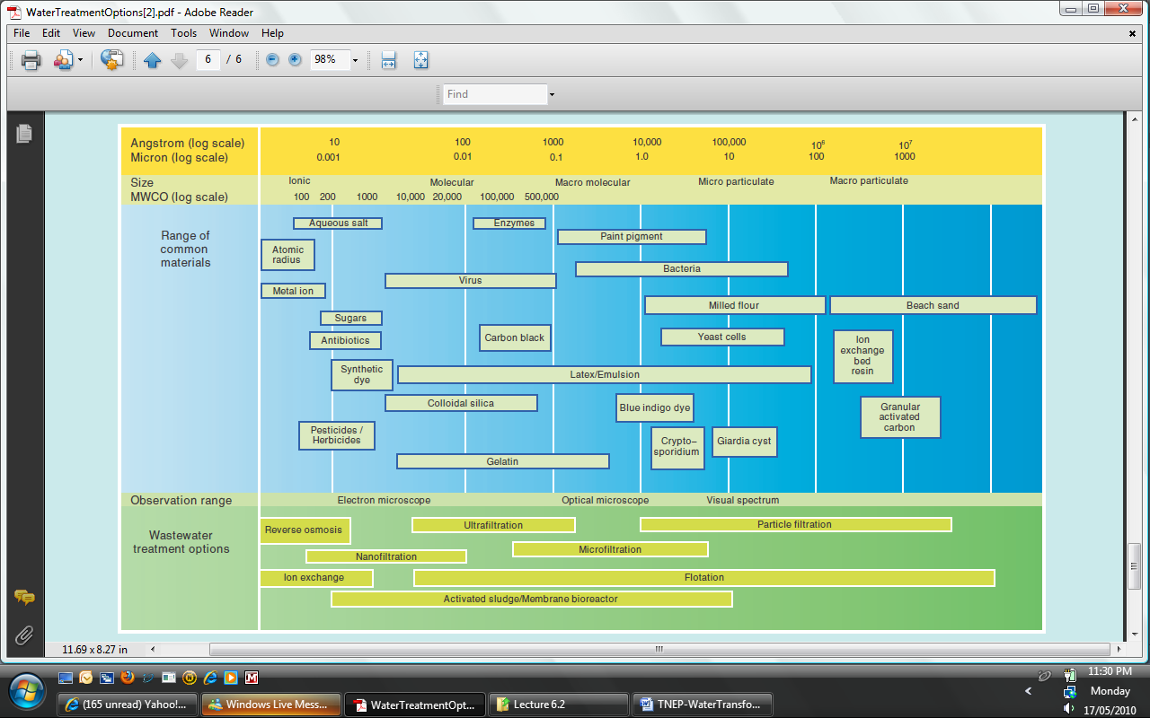
Eco-efficiency
Examples: water treatment
(Sydney Water 2009)
Notes:
Sydney Water 2009, Water Treatment Options, Sydney Water. Available at <www.sydneywater.com.au/Publications/FactSheets/WaterTreatmentOptions.pdf>. Accessed 15 May 2010.

Slide 31
Eco-efficiency
Resource | Minimise
Materials | Materials un-recovered Materials adversely disturbed
Energy | Energy un-recovered
Space | Space required
Biological impact | Toxic impact
Skill: Increase eco-efficiency
Activity
For your system, identify the resources with largest potential for an increase in eco-efficiency
Identify eco-efficient options that are relevant to your system

Slide 32
Eco-effectiveness
Notes:
We’ll use a strategy called eco-effectiveness to introduce design options that increase the regenerative capacity.

Slide 33
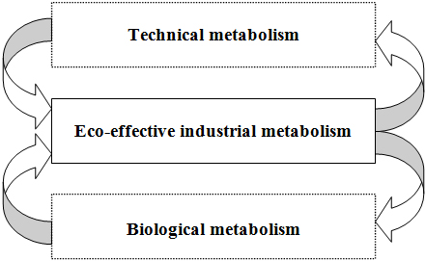
Eco-effectiveness
Waste equals food
Maximise the positive impacts through benign or regenerative design
Foreign and often toxic to the biosphere (e.g., PET)
Products of service
Decompose in and nourish the biosphere (e.g., cotton)
Products of consumption
(Braungart et al. 2006; McDonough & Braungart 2001)
Notes:
McDonough, W. and Braungart, M. (2002) Cradle to cradle: Remaking the way we make things, North Point Press, New York.
The diagram shows two metabolisms—the technical metabolism on the top and the biological metabolism at the bottom. We get an eco-effective industrial metabolism when we have both of those metabolisms operating concurrently and closed loop, avoiding cross contamination of nutrients.
In the technical metabolism, we want to retain the materials that are foreign and often toxic to the biosphere. Such materials include plastics, minerals, and metals. They are generally used in products of service, usually long-life products that we use repeatedly to get multiple services.
In the biological metabolism, we want to retain the materials that decompose in and nourish the biosphere. Such materials include plant-based materials like cotton, natural paper, and untreated wood. They are generally used in products of consumption, which usually wear out or get lost, requiring replacement.
In the technical metabolism, we rely on industry processes to recover, reuse, and recycle technical nutrients forever, avoiding any contamination of the biosphere. In that way our impact can be benign.
In the biological metabolism, we rely on the earth’s processes to recover, reuse, and recycle biological nutrients, which, in the right places, can have a regenerative effect on the environment.

Slide 34
Eco-effectiveness
Typical actions:
Separate biological and technical materials
Return natural or synthetic, biodegradable resources to the biosphere without contamination
Positive contribution to the biosphere
Perpetually reuse natural or synthetic, non-biodegradable resources without loss of integrity
No contamination of the biosphere or resources
Fully utilise each resource
(Braungart et al. 2006; McDonough & Braungart 2001)
Notes:
McDonough, W. and Braungart, M. (2002) Cradle to cradle: Remaking the way we make things, North Point Press, New York.

Slide 35
Eco-effectiveness
What is the optimal service?
eco-effectiveness
Resource | Minimise | Maximise
Materials | Materials un-recovered Materials adversely disturbed | Materials upgraded Materials favourably dispersed
Energy | Energy un-recovered | Energy upgraded
Space | Space required
Biological impact | Toxic impact | Restorative impact

Slide 36
Eco-effectiveness
Examples: ice cream packaging (biological nutrient)
Biodegradeable
Made from a polymer that solidifies in the freezer, and melts and degrades at ambient temperature
Incorporates seeds of rare plants
Seeds germinate in soil and support biodiversity
Net positive impact on the natural environment
(Timmins 2002)
Notes:
Timmins, K.J. 2002, 20-26 October, United Nations Industrial Development Organisation. Available at http://www.unido.org/index.php?id=o7982. Accessed 17 November 2008.

Slide 37
Eco-effectiveness
Examples: carpet tile (technical nutrient)
Modular
Each piece replaced individually
Leased
Reused and recycled
Also an example of biomimicry
(AskNaure; McDonough & Braungart 2001)
Notes:
AskNature, i2 Modular Carpet, https://asknature.org/idea/i2-modular-carpet/#.XI36wdozZYE
McDonough, W. and Braungart, M. 2001, Eco-effectiveness, Greenleaf Publishing.

Slide 38
Eco-effectiveness
Resource | Maximise
Materials | Materials upgraded Materials favourably dispersed
Energy | Energy upgraded
Space
Biological impact | Restorative impact
Skill: Increase eco-effectiveness
Activity
For your system, identify the hardware that could be made of biological nutrients
For your system, identify the hardware that should be made of technical nutrients
Example – wood chipper:
Biological: chipping contact surface – bio-ceramic
Technical: wood chip container – steel

Slide 39
Whole-systems thinking
Notes:
We’ll use a strategy called whole-systems thinking to identify leverage points for meeting the design requirements.

Slide 40
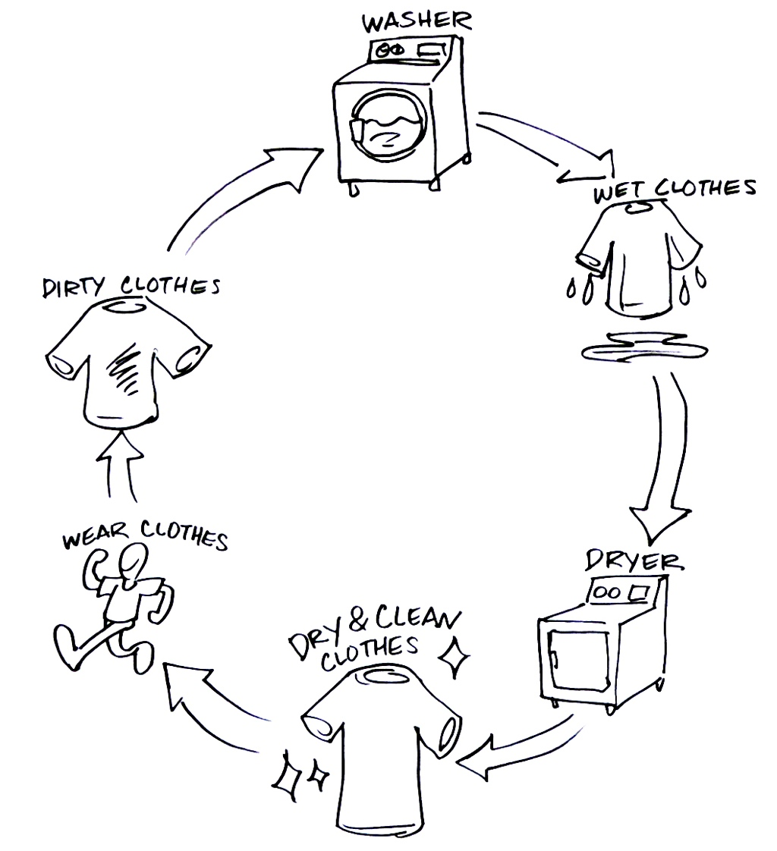
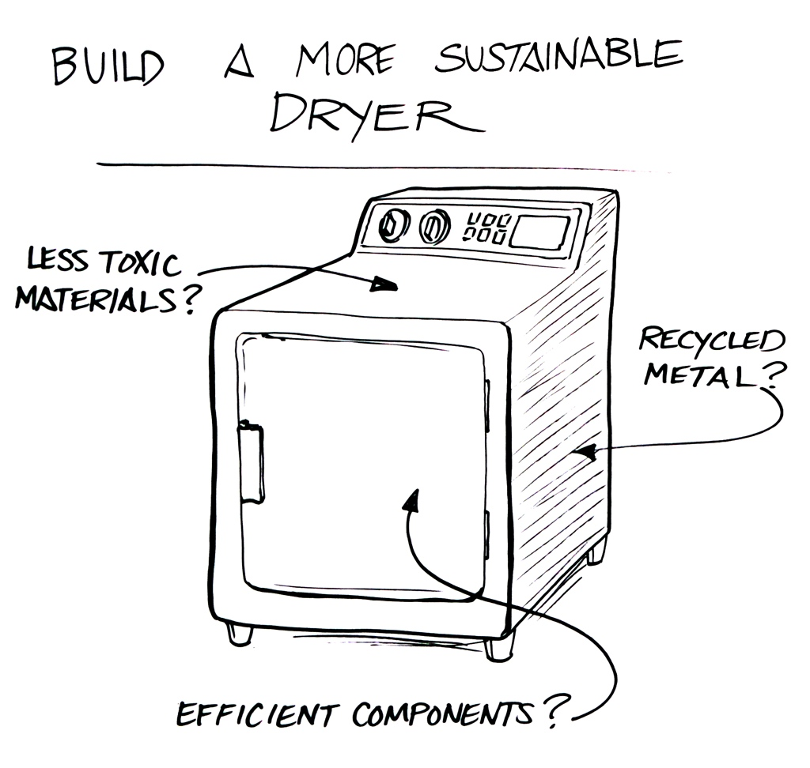
Whole-systems thinking
Identify the interactions between the system and the environment
(Autodesk 2018)
Notes:
Autodesk 2018, Whole Systems and Lifecycle Thinking - Part 1, Autodesk, <https://knowledge.autodesk.com/support/inventor-products/getting-started/caas/simplecontent/content/whole-systems-and-lifecycle-thinking-part-1.html.html>, viewed 16 March 2019.
The example shows the operating environment, but we can also consider the production environment and end-of-life environment.

Slide 41
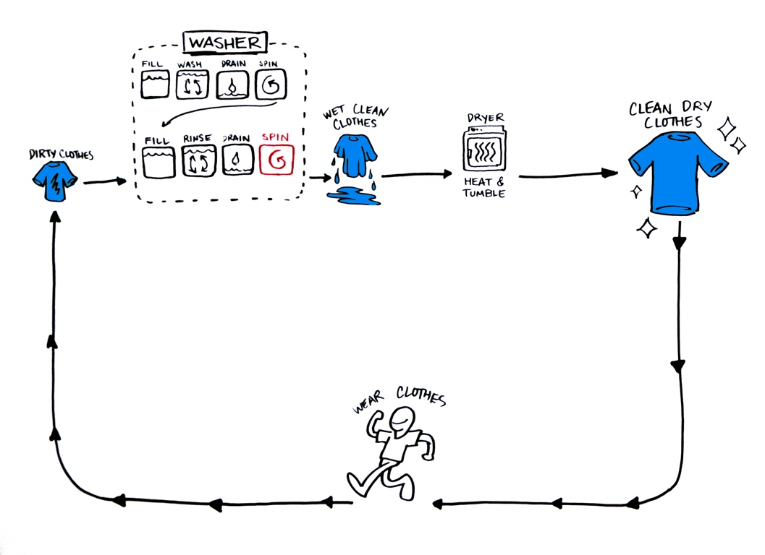
Whole-systems thinking
Identify leverage points for change
Leverage point
(Autodesk 2018)
Notes:
Autodesk 2018, Whole Systems and Lifecycle Thinking - Part 1, Autodesk, <https://knowledge.autodesk.com/support/inventor-products/getting-started/caas/simplecontent/content/whole-systems-and-lifecycle-thinking-part-1.html.html>, viewed 16 March 2019.

Slide 42
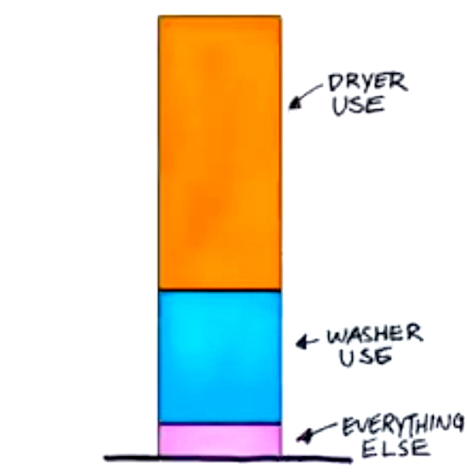
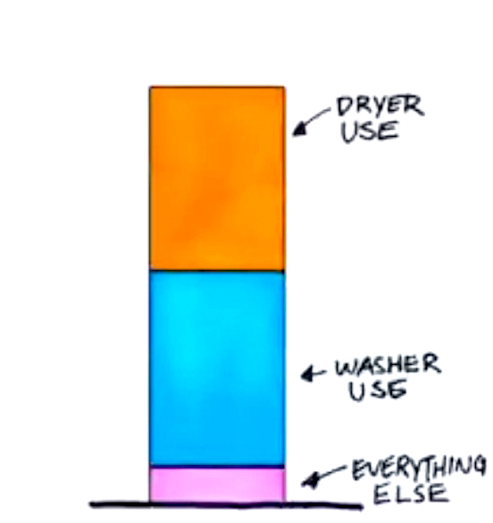
Whole-systems thinking
Identify leverage points for change
Before After
(Autodesk 2018)
effect
cause
Notes:
Autodesk 2018, Whole Systems and Lifecycle Thinking - Part 1, Autodesk, <https://knowledge.autodesk.com/support/inventor-products/getting-started/caas/simplecontent/content/whole-systems-and-lifecycle-thinking-part-1.html.html>, viewed 16 March 2019.

Slide 43
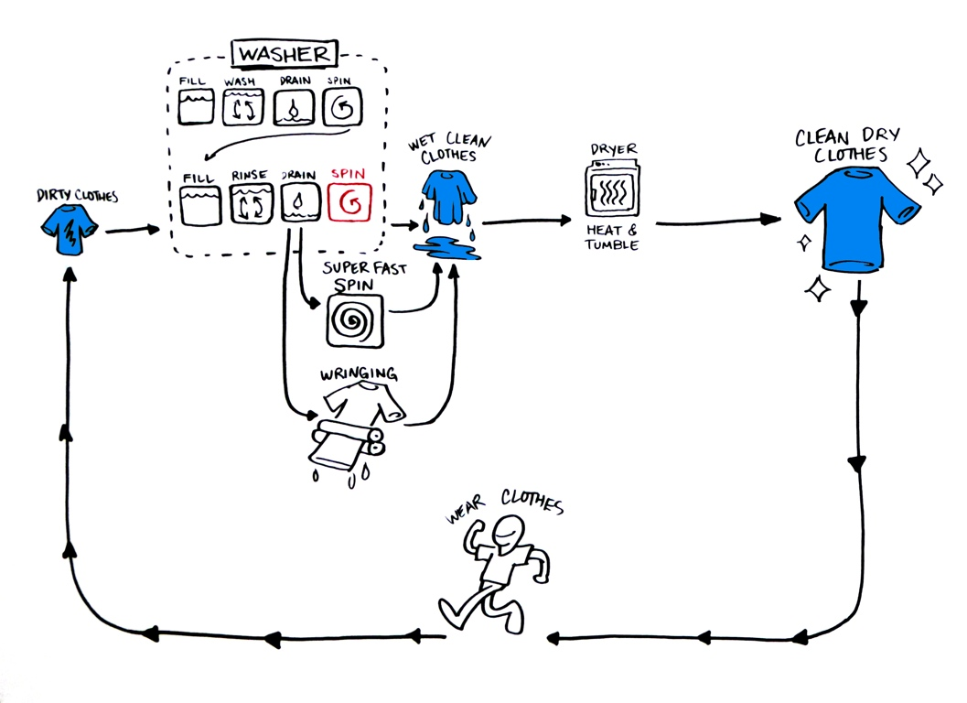
Whole-systems thinking
Identify interventions for change
(Autodesk 2018)
Notes:
Autodesk 2018, Whole Systems and Lifecycle Thinking - Part 1, Autodesk, <https://knowledge.autodesk.com/support/inventor-products/getting-started/caas/simplecontent/content/whole-systems-and-lifecycle-thinking-part-1.html.html>, viewed 16 March 2019.

Slide 44
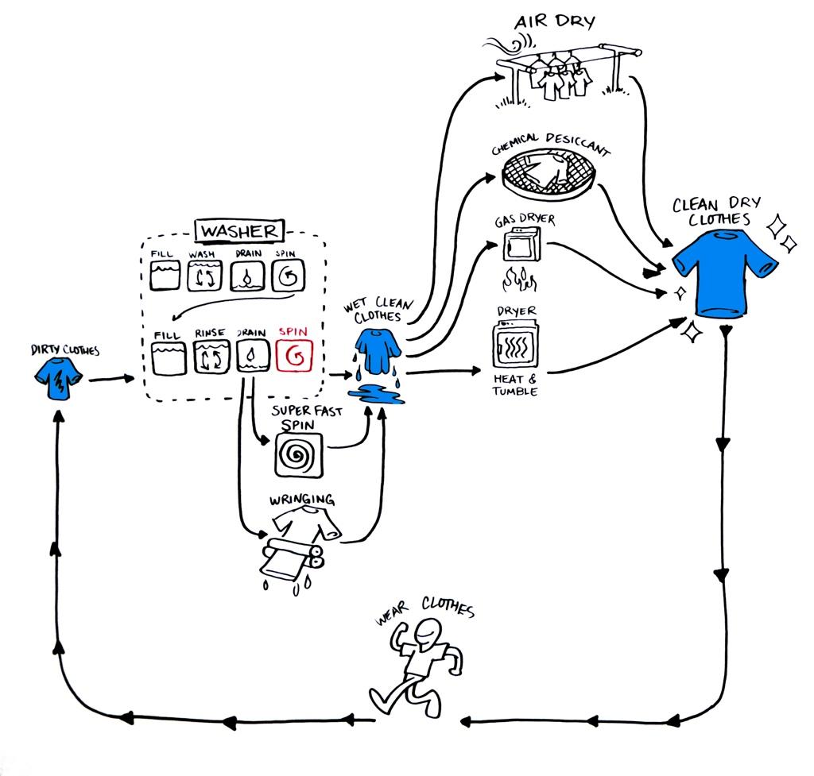
Whole-systems thinking
Identify interventions for change
(Autodesk 2018)
Notes:
Autodesk 2018, Whole Systems and Lifecycle Thinking - Part 1, Autodesk, <https://knowledge.autodesk.com/support/inventor-products/getting-started/caas/simplecontent/content/whole-systems-and-lifecycle-thinking-part-1.html.html>, viewed 16 March 2019.

Slide 45
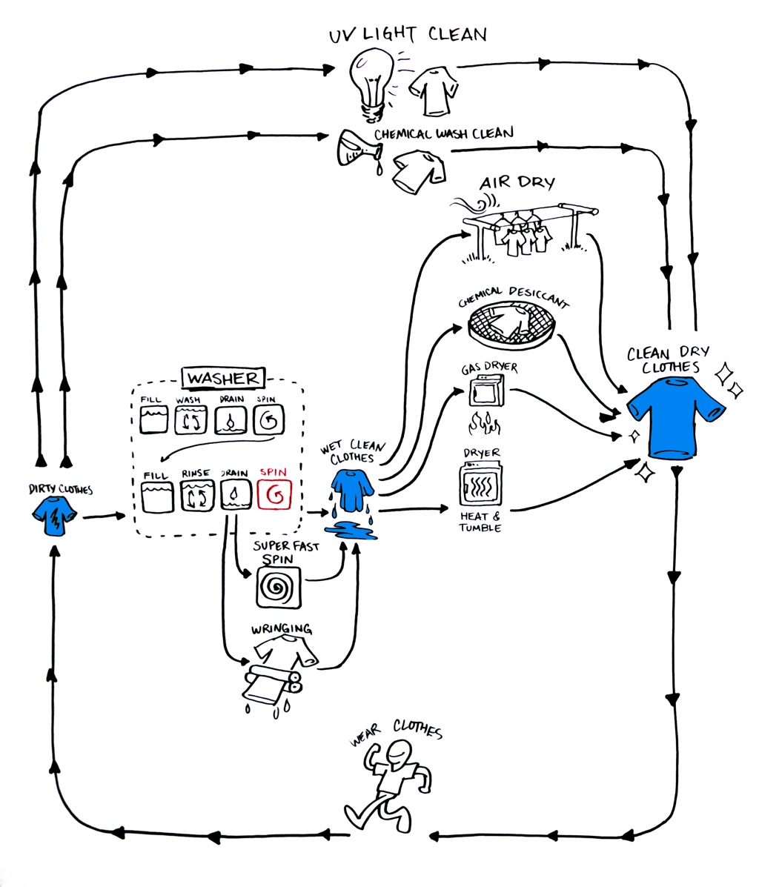
Whole-systems thinking
Identify leverage points for change
Identify interventions for change
(Autodesk 2018)
Notes:
Autodesk 2018, Whole Systems and Lifecycle Thinking - Part 1, Autodesk, <https://knowledge.autodesk.com/support/inventor-products/getting-started/caas/simplecontent/content/whole-systems-and-lifecycle-thinking-part-1.html.html>, viewed 16 March 2019.

Slide 46
Whole-systems thinking
Skill: Identify leverage points using whole system thinking
Activity
Identify the interactions between your system and its operating environment
Example – dwelling: workplace, school, supermarket, transport vehicles
Example – computer:
Upstream: information, thoughts
Downstream: documents, computer models
Identify the leverage points for improving the performance
Identify options that improve the performance

Slide 47
Thanks!
Notes:
We’ve now concluded our processes for the Conceptual Design phase. We generated a set of plausible concepts to solve our problem, and then we selected the concept with the highest potential to satisfy our design requirements. Next, we’ll start our processes for the Preliminary Design phase.

Slide 48
Assessment tasks
Week 1-2
Week 3 ________ ________ ________
Week 4 ________ ________ ________
… | …
Week 11 ________ ________ ________
Project
Project
Project-based learning
Lectures: learn fundamental content and skills
Private: apply content and skills to your group project
Tutorials: get feedback on your group project
Private: revise group project based on feedback
Project
Project

Slide 49
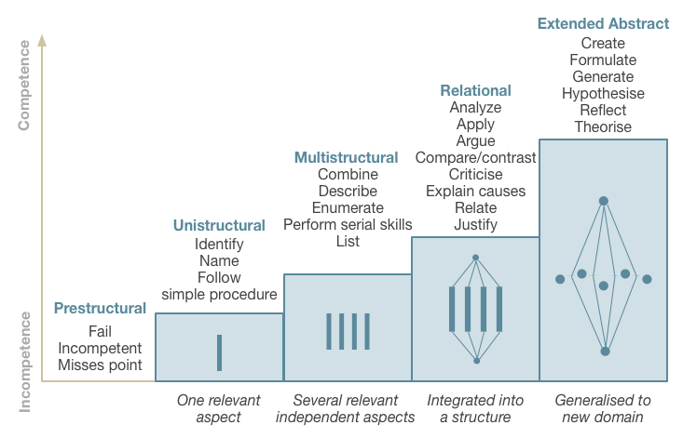
Assessment standards
SOLO taxonomy
Video (4 min)
Text (100 words)
Source: The Australian National University 2014, Unravelling Complexity, The Australian National University, Canberra. http://vc-courses.anu.edu.au/uc/home, viewed 4 March 2014.

